Slide 1
Nourriture - Connect People with Ingredients
fastDev@RWD+Bootstrap
Beijing Jiao Tong University

Slide 2
The Basis of Responsive Web Design
Beijing Jiao Tong University

Slide 3
What RWD
Responsive web design is an approach to web design aimed at crafting sites to provide an optimal viewing experience - easy reading and navigation with a minimum of resizing and scrolling - across a wide range of devices from desktop computer to mobile phones.
Beijing Jiao Tong University

Slide 4
How RWD
A RWDed site adapts layout to view system by using
Fluid grid concept
Page element sizing to be in relative units like percentages, rather than absolute units like pixels
Flexible images
Size of images in relative units, so as to prevent them from displaying outside their containing element
Media queries
Use different CSS style rules based on characteristics of the device the site is being displayed on, most commonly the width of the browser
Beijing Jiao Tong University

Slide 5

RWD Look & Feel (from small to large)
Beijing Jiao Tong University

Slide 6
How Magic Happens
Mobile browsers will render the page at a desktop screen width (usually about 980px), and then try to make the content look better by increasing font sizes and scaling the content to fit the screen
But… How?
The meta Viewport (the trigger)
The relative unit (the relationship)
The media query (the filter)
Beijing Jiao Tong University
Notes:
Dimension:面积(x*y)

Slide 7
Device Independent Pixel (dp)
density-independent pixel, dip, dp is a physical unit of measurement based on a co-ordinate system and represents an abstraction of a pixel
Conversion between dp and pixel
As dp is a physical unit it has an absolute value which can be measured in traditional units, e.g. for Android devices 1 dp equals 1/160 of inch or 0.15875 mm.
A device-independent pixel is equivalent to one physical pixel on a 160 dpi (dot per inch (2.54 cm)) screen
Beijing Jiao Tong University
Notes:
Dimension:面积(x*y)
Millimeter:毫米
Centimeter:厘米

Slide 8
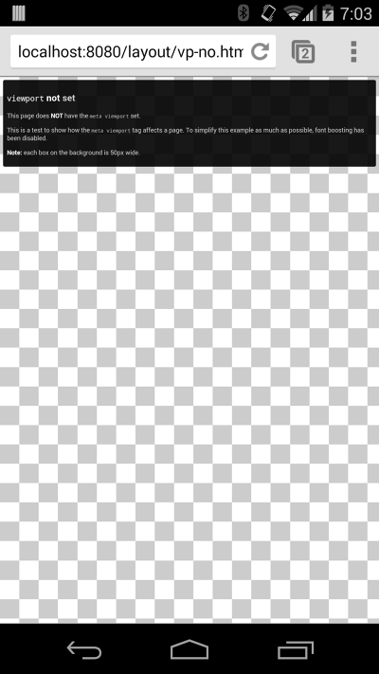
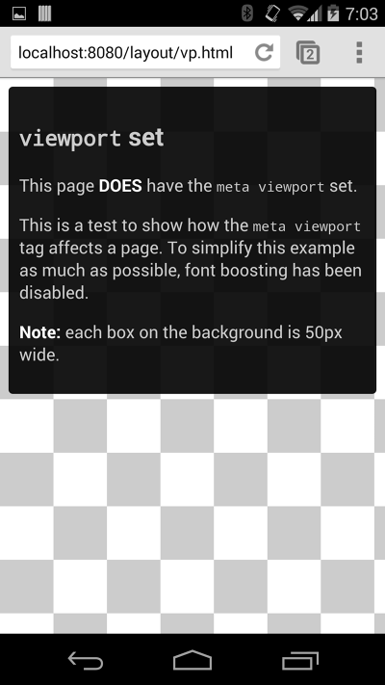

Set the viewport
meta viewport tag gives the browser instructions on how to control the page's dimensions and scaling.
Instruct the page to match the screen’s width in device independent pixels.
Instruct browsers to establish a 1:1 relationship between CSS pixels and device independent pixels regardless of device orientation, and allows the page to take advantage of the full landscape width
double-tap or pinch-to-zoom
When set, these can disable the user’s ability to zoom the viewport
Beijing Jiao Tong University
Notes:
Dimension:面积(x*y)

Slide 9
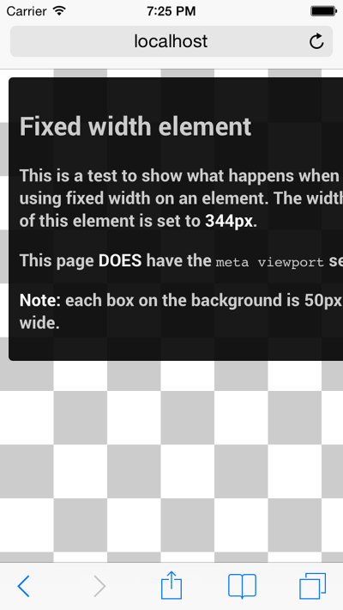
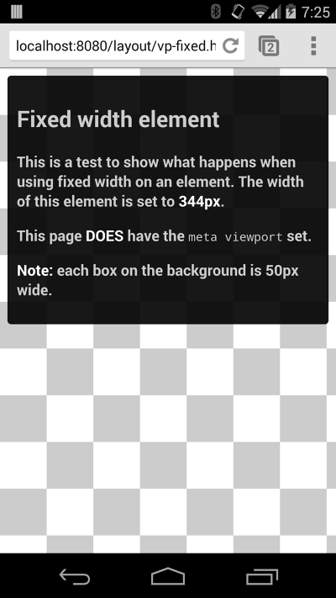
Size content to the viewport
For example, an image that is displayed at a width wider than the viewport can cause the viewport to scroll horizontally.
A device with a width of 320 CSS pixels, but the width set to the div is 344 px
Instead, consider using relative width values, such as width: 100%
Beijing Jiao Tong University
Notes:
Dimension:面积(x*y)
Millimeter:毫米
Centimeter:厘米

Slide 10
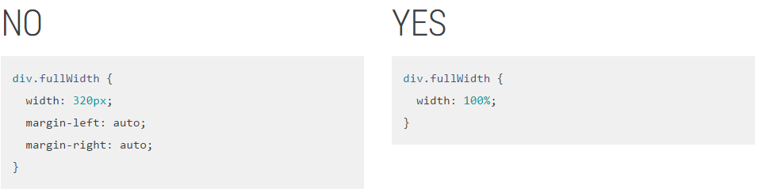
Use relative units
Using relative units for measurements can help simplify layouts and prevent accidentally creating components that are too big for the viewport.
In addition, it allows browsers to render the content based on the users zoom level without the need for adding horizontal scroll bars to the page.
Beijing Jiao Tong University
Notes:
Dimension:面积(x*y)
Millimeter:毫米
Centimeter:厘米

Slide 11
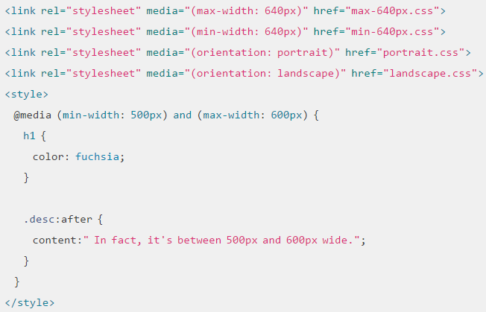
Use CSS media queries for responsiveness
Media queries are simple filters that can be applied to CSS styles, so as to render content dynamically
attribute | Result
min-width | Rules applied for any browser width over the value defined in the query.
max-width | Rules applied for any browser width below the value defined in the query.
min-height | Rules applied for any browser height over the value defined in the query.
max-height | Rules applied for any browser height below the value defined in the query.
orientation=portrait | Rules applied for any browser where the height is greater than or equal to the width.
orientation=landscape | Rules for any browser where the width is greater than the height.
Example: http://googlesamples.github.io/web-fundamentals/samples/layouts/rwd-fundamentals/media-queries.html
Beijing Jiao Tong University
Notes:
Dimension:面积(x*y)
Millimeter:毫米
Centimeter:厘米

Slide 12
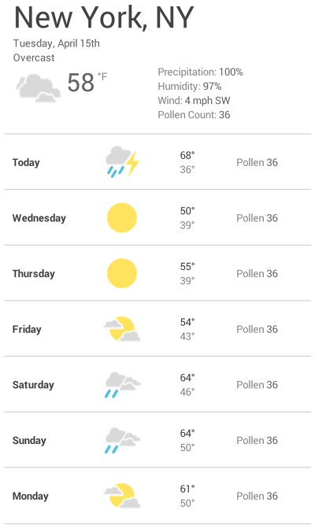
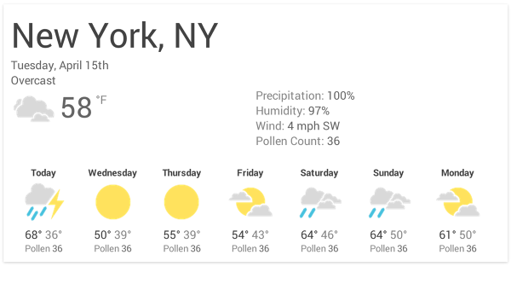
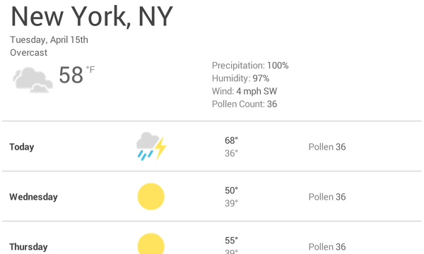
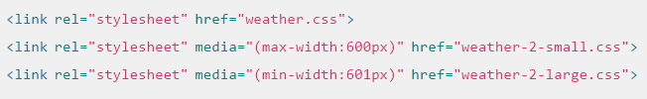
How to choose breakpoints
Design the content to fit on a small screen size first, then expand the screen until a breakpoint becomes necessary.
Resize the browser until there is too much white space between the elements and the forecast simply doesn’t look as good.
To insert a breakpoint at 600px, create two new stylesheets,
Place the common styles such as fonts, icons, basic positioning, colors in weather.css, and place specific layouts separately
Beijing Jiao Tong University
Notes:
Dimension:面积(x*y)
Millimeter:毫米
Centimeter:厘米

Slide 13
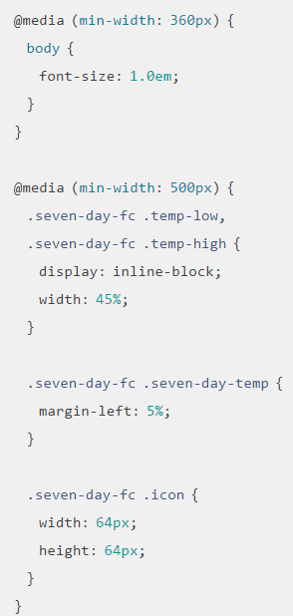
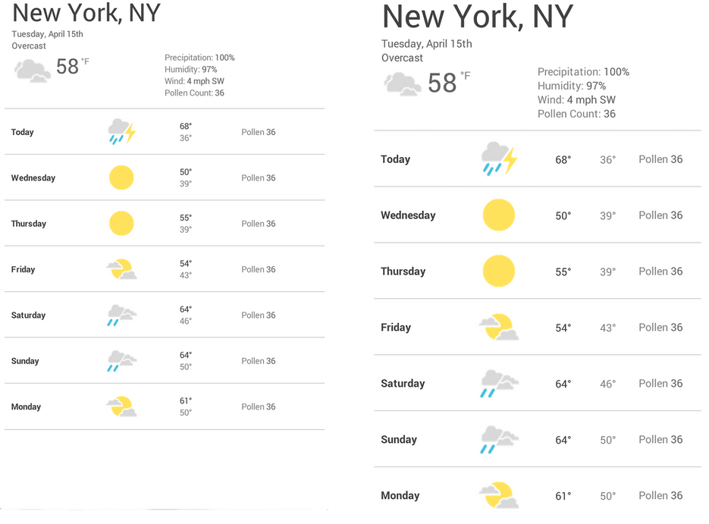
Pick minor breakpoints when necessary
In addition to choosing major breakpoints when layout changes significantly, it is also helpful to adjust for minor changes between major changes
Beijing Jiao Tong University
Notes:
Dimension:面积(x*y)
Millimeter:毫米
Centimeter:厘米

Slide 14
The Responsive Web Design Pattern
Beijing Jiao Tong University

Slide 15
Category of RWD Patterns
Mostly fluid
Column drop
Layout shifter
Tiny tweaks
Off canvas.
Beijing Jiao Tong University

Slide 16
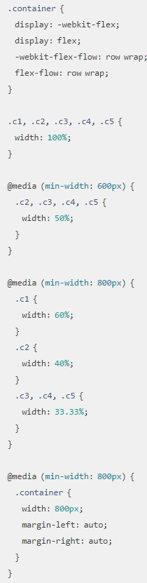
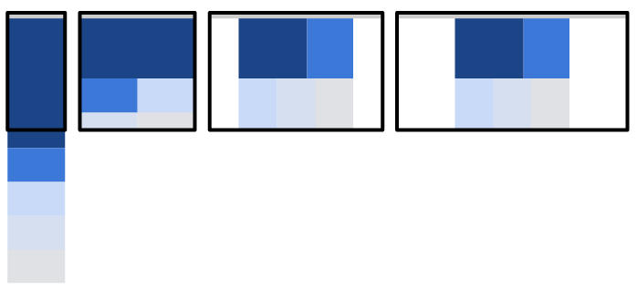
Mostly fluid (grid)
On smaller screens, the fluid grid causes the main content to reflow, while columns are stacked vertically.
Benefit: it usually only requires one breakpoint between small screens and large screens.
Example: http://googlesamples.github.io/web-fundamentals/samples/layouts/rwd-patterns/mostly-fluid.html
Beijing Jiao Tong University
Notes:
Dimension:面积(x*y)
Millimeter:毫米
Centimeter:厘米

Slide 17
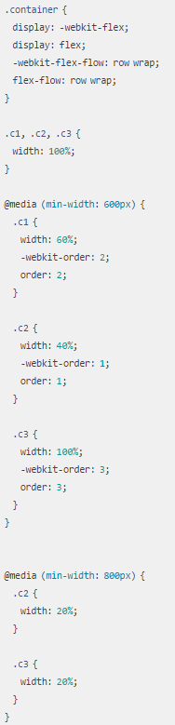
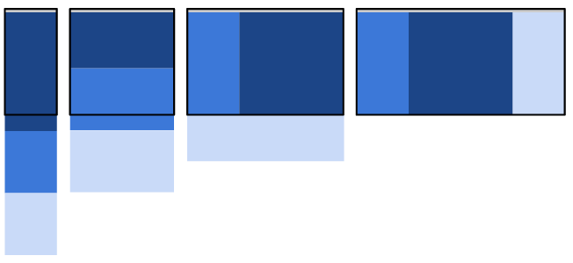
Column drop
Eventually this results in all of the columns being stacked vertically, which is quite same like mostly fluid sample, but
as the screen expands beyond 600px, the primary and secondary content div’s take the full width of the screen.
Example: http://googlesamples.github.io/web-fundamentals/samples/layouts/rwd-patterns/column-drop.html
Beijing Jiao Tong University
Notes:
Dimension:面积(x*y)
Millimeter:毫米
Centimeter:厘米

Slide 18
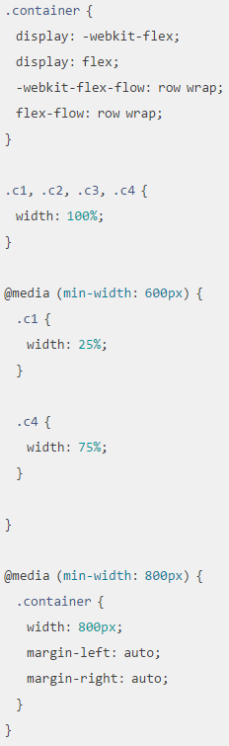
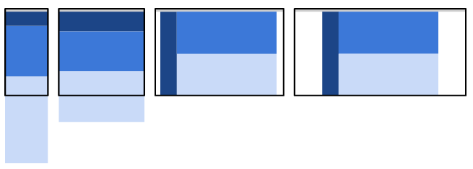
Layout shifter
Key to this layout is the way content moves about, instead of reflowing and dropping below other columns.
On smaller screens content is stacked vertically, but changes significantly as the screen becomes larger, with a left div and two stacked div’s on the right.
Example: http://googlesamples.github.io/web-fundamentals/samples/layouts/rwd-patterns/layout-shifter.html
Beijing Jiao Tong University
Notes:
Dimension:面积(x*y)
Millimeter:毫米
Centimeter:厘米

Slide 19
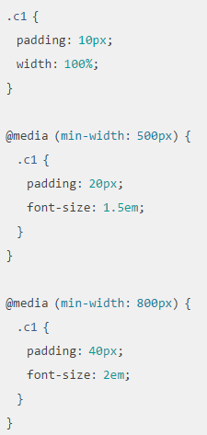
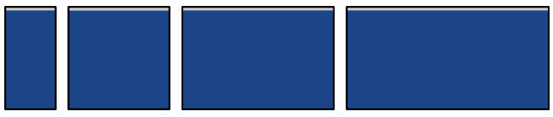
Tiny tweaks
Simply makes small changes to the layout, such as adjusting font size, resizing images or moving content around in very minor ways
It works well on single column layouts such as one page linear websites, text heavy articles.
Example: http://googlesamples.github.io/web-fundamentals/samples/layouts/rwd-patterns/tiny-tweaks.html
Beijing Jiao Tong University
Notes:
Dimension:面积(x*y)
Millimeter:毫米
Centimeter:厘米

Slide 20
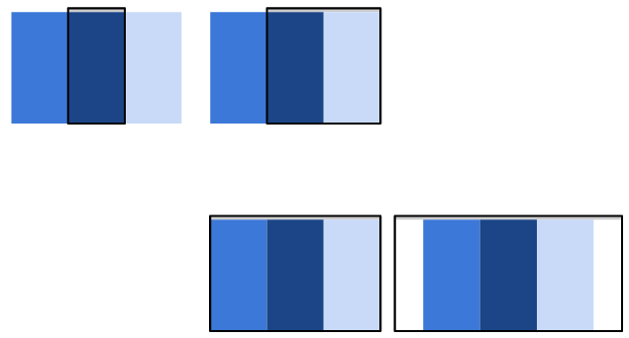
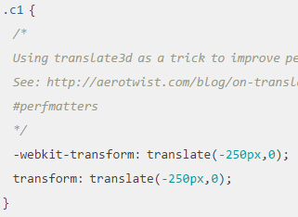
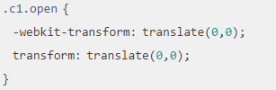
Off canvas
Transform:translate (-250px, 0) means ‘hide’
Rather than stacking content vertically, the off canvas pattern places less frequently used content, perhaps navigation or app menus off screen, only showing it when the screen size is large enough, and on smaller screens, content is only a click away.
Example: http://googlesamples.github.io/web-fundamentals/samples/layouts/rwd-patterns/off-canvas.html
Beijing Jiao Tong University
Notes:
Dimension:面积(x*y)
Millimeter:毫米
Centimeter:厘米

Slide 21
Get Started with Bootstrap
Beijing Jiao Tong University

Slide 22
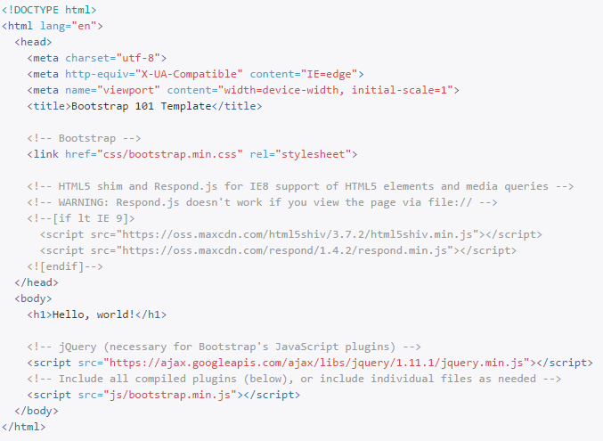
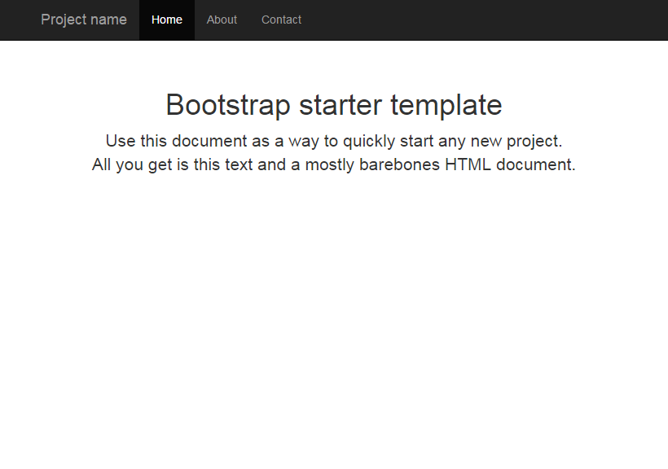
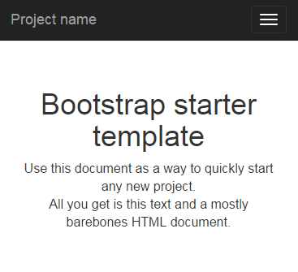
Overview
HTML5 doctype
Edge mode tells Internet Explorer to display content in the highest mode available
Mobile first
Bootstrap CSS
all JavaScript plugins of Bootstrap require jQuery to be included
Beijing Jiao Tong University

Slide 23
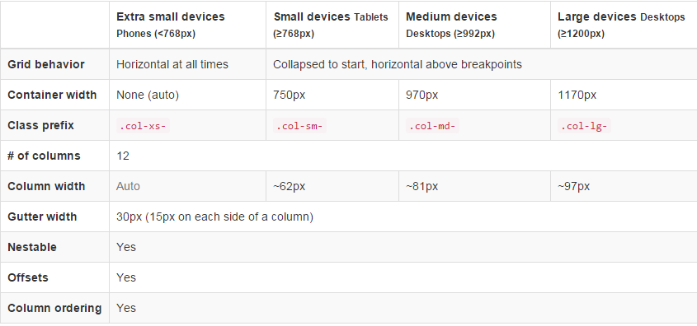
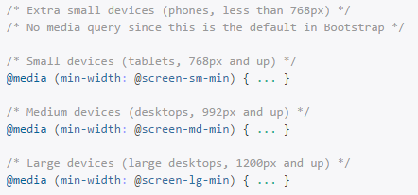
Grid System (Heart to makes bootstrap responsive)
Bootstrap includes a responsive, mobile first fluid grid system that appropriately scales up to 12 columns as the device or viewport size increases, so as to fit on a small screen size first, then expand the screen whenever needed gradually
Phone -> Tablet -> Desktop -> Large Desktop
Grid Options
Media Query
Beijing Jiao Tong University
Notes:
Dimension:面积(x*y)
Millimeter:毫米
Centimeter:厘米

Slide 24
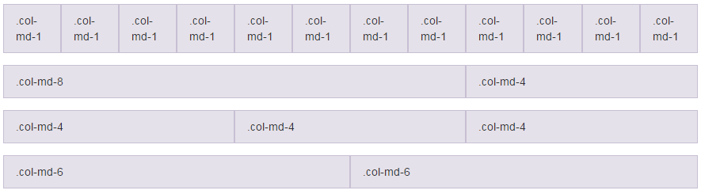
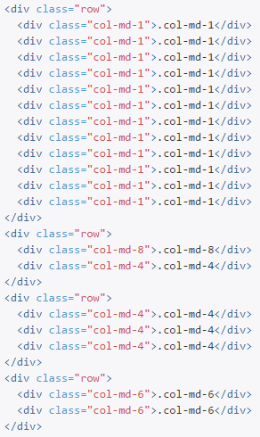
Example: Stacked-to-horizontal
Using a single set of .col-md-* grid classes to create a basic grid system
Beijing Jiao Tong University
Notes:
Dimension:面积(x*y)
Millimeter:毫米
Centimeter:厘米

Slide 25
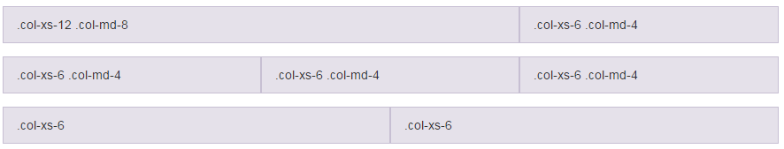
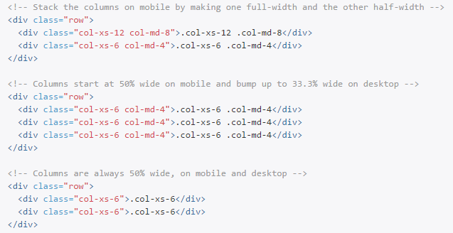
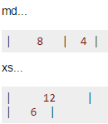
Example: Mobile and desktop
Using multiple grid class
Beijing Jiao Tong University
Notes:
Dimension:面积(x*y)
Millimeter:毫米
Centimeter:厘米

Slide 26
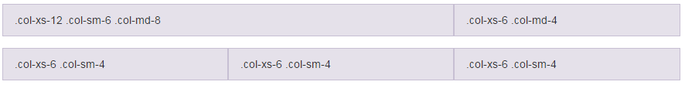
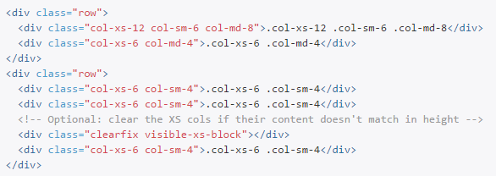
Example: Mobile, tablet, desktop
Using multiple grid class
Beijing Jiao Tong University
Notes:
Dimension:面积(x*y)
Millimeter:毫米
Centimeter:厘米

Slide 27
Example: Mobile, tablet, desktop
Using multiple grid class
Beijing Jiao Tong University
Notes:
Dimension:面积(x*y)
Millimeter:毫米
Centimeter:厘米

Slide 28
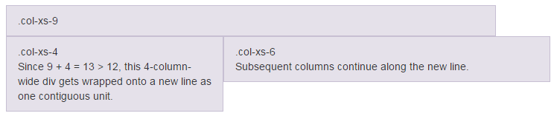
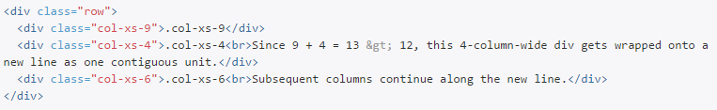
Example: Column wrapping
If more than 12 columns are placed within a single row, each group of extra columns will, as one unit, wrap onto a new line.
Beijing Jiao Tong University
Notes:
Dimension:面积(x*y)
Millimeter:毫米
Centimeter:厘米

Slide 29
Notice about Grid System
Grid classes for a given screen size apply to that screen size and larger unless another declaration overrides it
i.e. col-xs-6 col-md-4 spans 6 columns on xs and sm, and 4 columns on md and lg, even though sm and lg were never explicitly declared
If you don't define xs, it will default to col-xs-12
i.e. col-sm-6 is half the width on sm, md and lg screens, but full-width on xs screens
It's actually totally fine if your .row includes more than 12 cols, as long as you are aware of how they will react.
Beijing Jiao Tong University
Notes:
Dimension:面积(x*y)
Millimeter:毫米
Centimeter:厘米

Slide 30
More…, please go to
http://getbootstrap.com/css/
Beijing Jiao Tong University

Slide 31
Reference
http://en.wikipedia.org/wiki/Responsive_web_design
http://alistapart.com/article/responsive-web-design/ https://developers.google.com/web/fundamentals/layouts/rwd-fundamentals/
https://developers.google.com/web/fundamentals/layouts/rwd-patterns/
http://stackoverflow.com/questions/24175998/meaning-of-numbers-in-col-md-4-col-xs-1-col-lg-2-in-bootstrap
http://stackoverflow.com/questions/21915636/bootstrap-3-and-col-xs-do-you-not-need-rows-of-12-units
Beijing Jiao Tong University

